Slide 1
CSS and BootStrap
Cascading Style Sheets

Slide 2
Codecademy
Do the Codecademy lab for the following modules
Site Structure
https://www.codecademy.com/learn/make-a-website
A Closer look at CSS
https://www.w3schools.com/Css/
Boundaries and Space
Building with Bootstrap
https://getbootstrap.com/docs/4.4/getting-started/introduction/

Slide 3
Examples from class
HTML Basics repo, Week CSS folder
Margins and Padding
https://gist.github.com/gtjames/1df94d99a9c3d65f7bf6791d4d7a8d1e
Transforms
https://gist.github.com/gtjames/8ee73cdb274fac15a7a7c50dd403e638

Slide 4
CSS Rules
{ attribute : value; }
Add a tag name in front of the opening curly and you have styles your first element
{
background-color: lightsteelblue;
color : red;
}

Slide 5
A few words about color

Slide 6
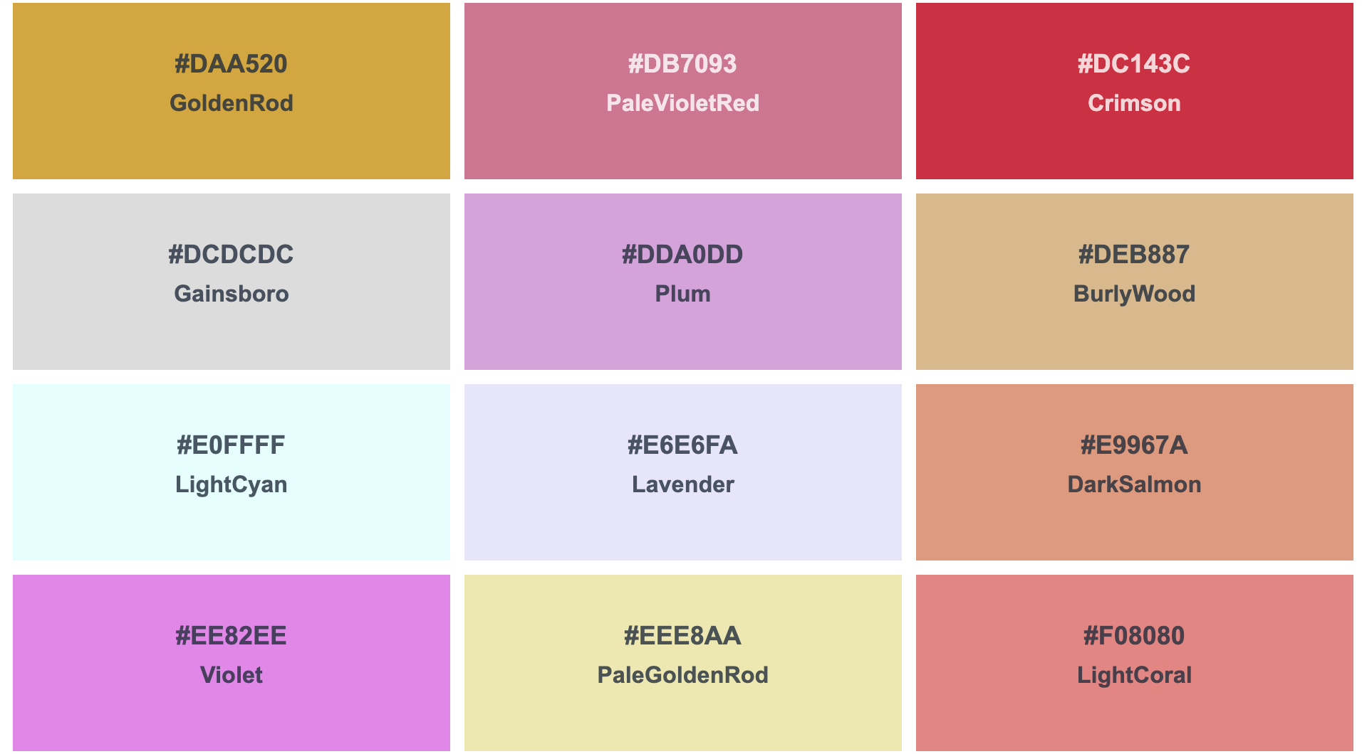
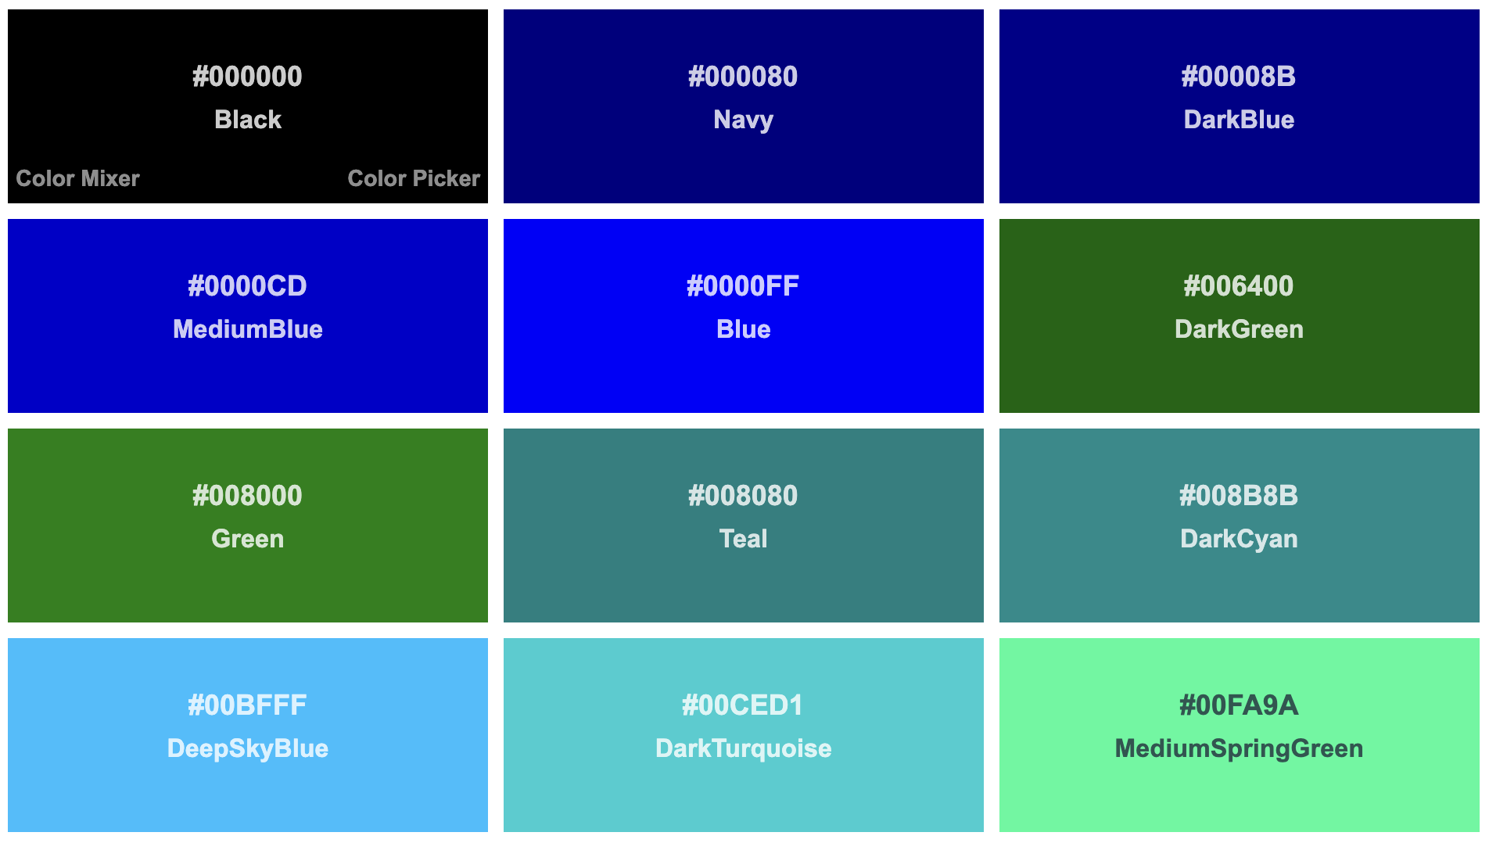
Colors
https://www.w3schools.com/colors/colors_names.asp
From AliceBlue to YellowGreen
140 to choose from
These colors have a name plus a hex value
But do you really want to mess with the hex values??

Slide 7
Hexadecimal Colors
A hexadecimal color is specified with: #RRGGBB.
RR (red), GG (green) and BB (blue)
Hexadecimal integers between 00 and FF specifying the intensity of the color.
For example,
#0000FF is displayed as blue, because the blue component is set to its highest value (FF) and the others are set to 00.
#00FF00 is displayed as green, because the red is 0 intensity, blue is 0 intensity, but the green is full FF (255)

Slide 8
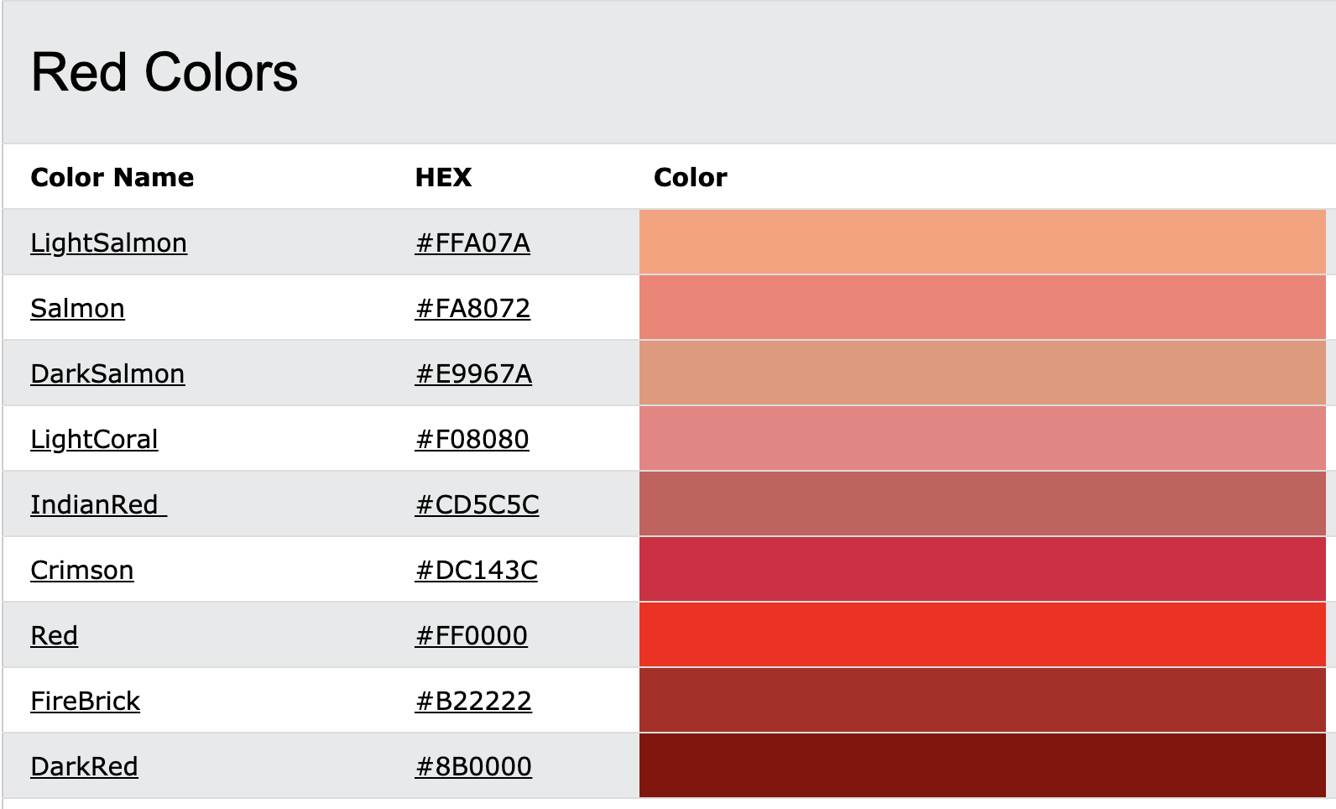
Need finer control over the color? use hexadecimal
Notice the ‘red’ values stay mostly red. They start with F
Pure Red is #FF0000
Dark Red is #800000 only 50% intensity

Slide 9
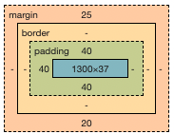
I need my space

Slide 10
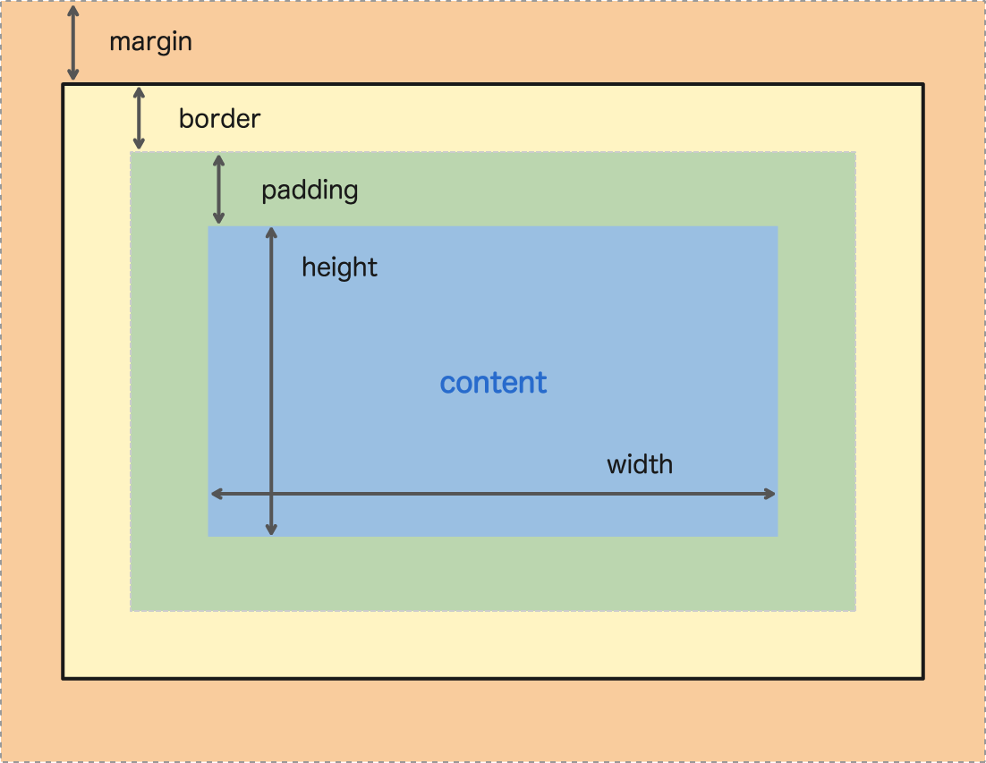
Margins, Borders and Padding

Slide 11
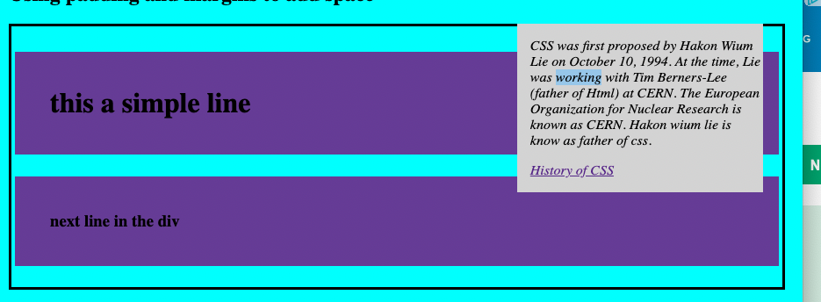
Adding padding and margins Styling an <aside>
margin-right: 25px;
margin: 25px 0px 20px 0px;
padding-left: 15px;
border-style: solid; padding: 4px;
padding: 40px 0px 40px 40px;

Slide 12
Styling for the last slide
div { border-style: solid; padding: 4px; } h1, h3 { margin: 25px 0px 20px 0px; padding: 40px 0px 40px 40px; background-color: rebeccapurple; }

Slide 13

Adding styling to an <aside>
aside { width: 30%; padding-left: 15px; margin-right: 15px; float: right; font-style: italic; background-color: lightgray; }
Margins and Padding.html
https://gist.github.com/1df94d99a9c3d65f7bf6791d4d7a8d1e

Slide 14
Identifying Screen Elements by type or attribute
Tag H1, p, div, tr
This is painting with a wide brush. ALL similar tags get the same style
CSS h1 { color : black; }
Id id=“firstName”
unique within the page
CSS #firstName { box-shadow: 10px 10px 10px grey; }
Class class=“active errorBorder”
multiple classes are acceptable
CSS .errorBorder { border: 2px solid red; }

Slide 15
Selecting an element to Style by type
Using the tag name
Tag { attribute: value; }
Body { background-color: orange; }
H1 { color: blue; }
All H1 elements will have blue text
table tbody tr:nth-child(odd) { background-color: lightgrey; }
All odd rows will be lightgrey

Slide 16
Selecting by #Id or .Class
#firstName { attribute: value; }
.errorBorder { border: 2px solid red; }
.shadow { box-shadow: forestgreen 10px 10px 10px; }
H1 { color: blue; }
table tbody tr:nth-child(odd) { background-color: #fafafa; }

Slide 17
Now for some examples

Slide 18
Adding movement
transition: 1s ease 5s;
Transition the attribute over a length of time
And in a certain manner (linear, ease, ease-in…)
Delay time before starting transition

Slide 19

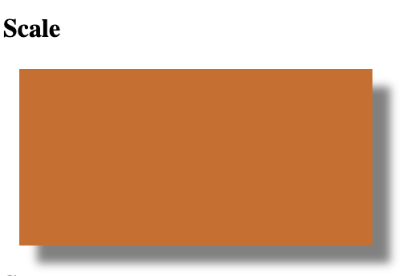
Scale Change dimensions of the DIV
div { width: 200px; height: 100px; margin-bottom: 5px; margin-left: 20px; transition: 1s ease; }
<h4>Scale</h4> <div id="scale"></div>
#scale { background-color: gold; }
#scale:hover { background-color: chocolate; transform: scale(1.1); box-shadow: 10px 10px 5px grey; }

